Slide 1
Function
Rakib Mahmud

Slide 2
Introduction
A function in C is a set of statements that when called perform some specific tasks.
It is the basic building block of a C program that provides code reusability.
The programming statements of a function are enclosed within { } braces, having certain meanings and performing certain operations.
They are also called subroutines or procedures in other languages.

Slide 3
Introduction (Cont’d)
Advantages of functions:
A program can be divided into small pieces that are easier to understand and modify.
We can avoid duplicating code that’s used more than once.

Slide 4
Types of Function
There are two types of function in C programming:
Standard library functions
User-defined functions

Slide 5
Standard Library Functions
The standard library functions are built-in functions in C programming.
These functions are defined in header files.
Example:
The printf() is a standard library function which displays output on the screen. This function is defined in the stdio.h header file.
The sqrt() function calculates the square root of a number. The function is defined in the math.h header file.

Slide 6
User-Defined Function
You can also create functions as per your need.
Such functions created by the user are known as user-defined functions.

Slide 7
General form of function
returnType functionName ( parameterList )
{
VariableDeclarations
Statements
}

Slide 8
Example of a function that computes maximum of two integers
int maximum(int a, int b)
{
if(a > b)
{
return a;
}
else
{
return b;
}
}
Comma separated argument list or parameters.
These are supplied values by the caller during it calls “maximum”
Return type -> int means this function returns
an integer value to its caller
Function name -> maximum means any caller can call this function by its name “maximum”
Function “maximum”’s body, which is enclosed in curly braces.

Slide 9
Function’s returning no values
void printMax(int a, int b)
{
if(a > b)
{
printf("%d\n",a);
}
else
{
printf("%d\n",b);
}
}
To indicate that a function has no return value, we specify that its return type is void.
void means nothing

Slide 10
Function with no parameters/argument list
void printThis( void )
{
int i;
for(i = 0; i<10; i++)
{
printf("*");
}
printf("\n");
}
When a function has no parameters, the word void is placed in parentheses after the function’s name
Or
Keep the parameter list empty

Slide 11
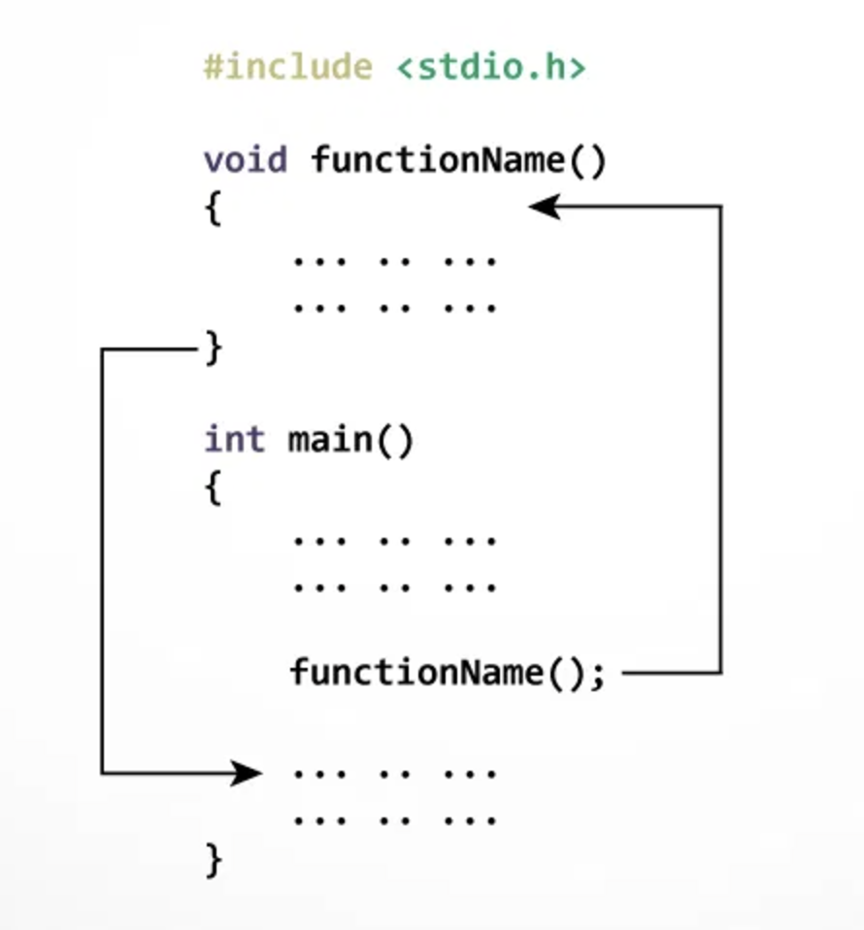
How Function Works in C Programming

Slide 12
How Function Works in C Programming (Cont’d)
The execution of a C program begins from the main() function.
When the compiler encounters functionName(); control of the program jumps to void functionName() and, the compiler starts executing the codes inside functionName().
The control of the program jumps back to the main() function once code inside the function definition is executed.

Slide 13
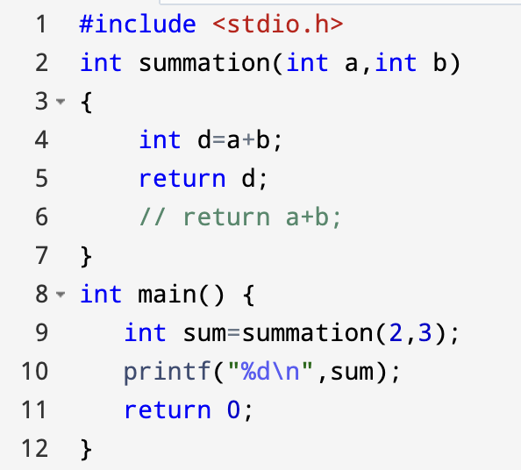
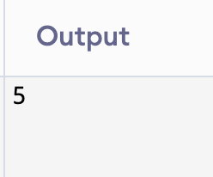
C Program to Find Sum of 2 Numbers Using Function

Slide 14
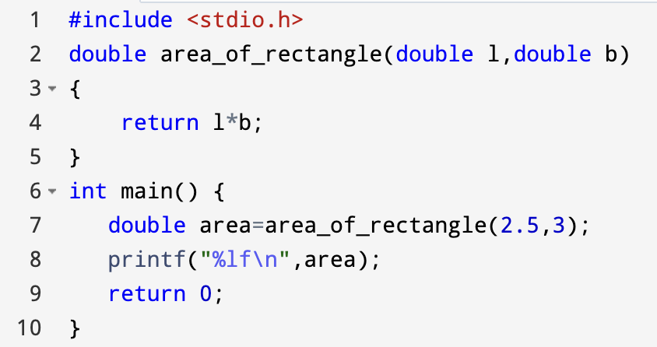
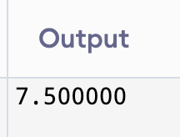
C Program to Find Area of Rectangle Using Function

Slide 15
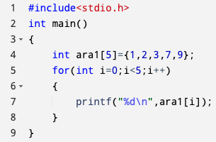
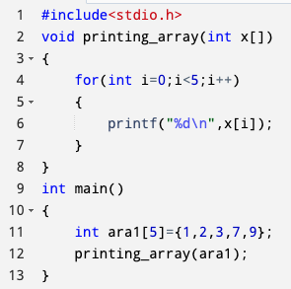
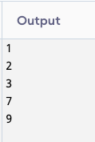
C Program for Passing Array to Function

Slide 16
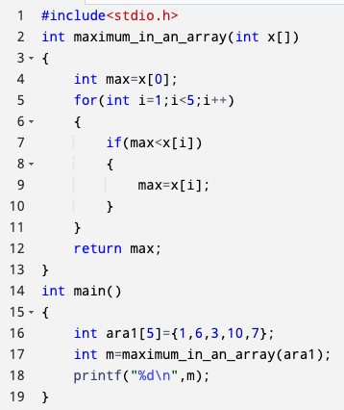

C Program for Finding Maximum Value of an Array Using Function

Slide 17
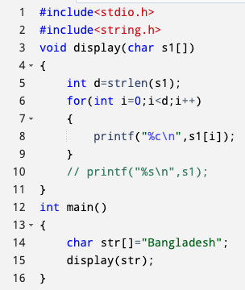
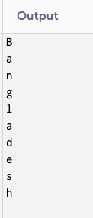
C Program for Passing String to Function

Slide 18
Recursion
Recursion is the process of a function calling itself repeatedly till the given condition is satisfied.
A function that calls itself directly or indirectly is called a recursive function and such kind of function calls are called recursive calls.

Slide 19
Recursion (Cont’d)
General Form of Recursion
Void fun(int n)
{
………
………
………
}
Int main( )
{
…..
.....
fun(x)
…..
…..
}
Type fun(param)
{
if(<base condition>)
{
……….
fun(param)
……….
}
}
There must be a base condition to terminate recursion

Slide 20
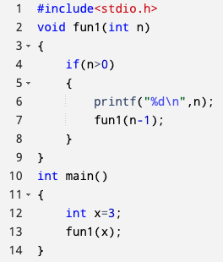
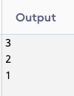
How Recursion Works
Recursive function is traced in the form of a tree
fun1(3)
3
fun1(2)
2
fun1(1)
1
fun1(0)

Slide 21
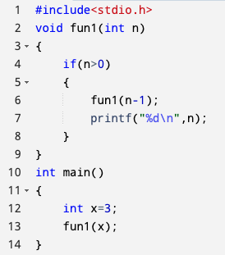
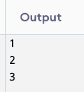
How Recursion Works (Cont’d)
fun1(3)
fun1(2)
3
fun1(1)
2
fun1(0)
1

Slide 22
Understanding Recursion Using Factorial
5! = 5*4*3*2*1
4! = 4*3*2*1
3! = 3*2*1
2! = 2*1
1! = 1
n! = n*(n-1)!

Slide 23
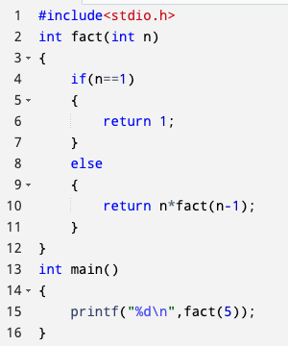

C Program for Finding Factorial Using Recursion

Slide 24
Thank You

